Slide 1
James Xu - PokeDex
T1A3 Terminal Application

Slide 2
What to cover
Pokedex App
App Features; how is it used?
App Logic & code
Development process review
Challenges
Ethical issues
Favourite parts

Slide 3
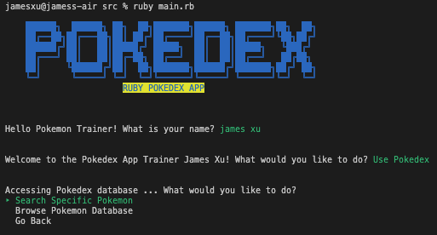
App Features
What can it do?
Search specific Pokemon data
Select from a list of Pokemon to view their data
Display Pokemon team data from user input (in progress)
Save data from user input as JSON file (in progress)

Slide 4
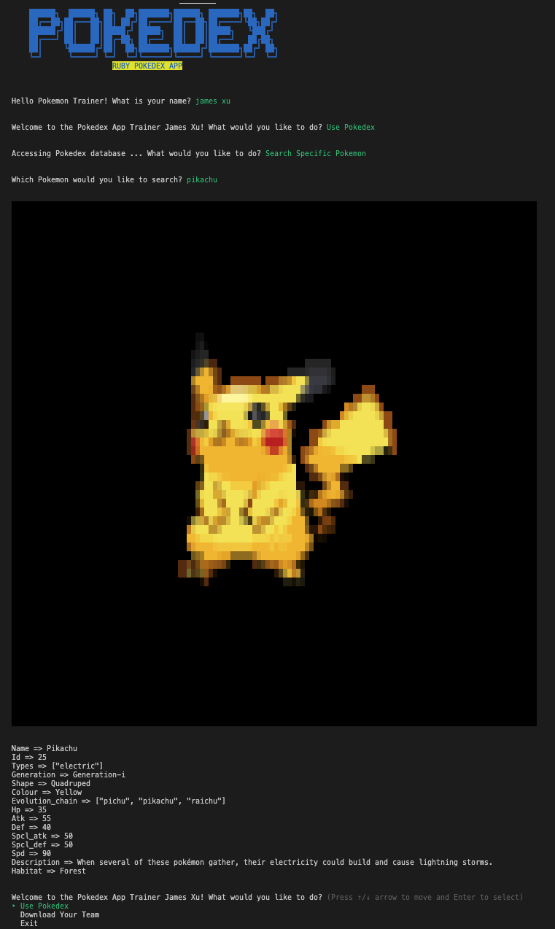

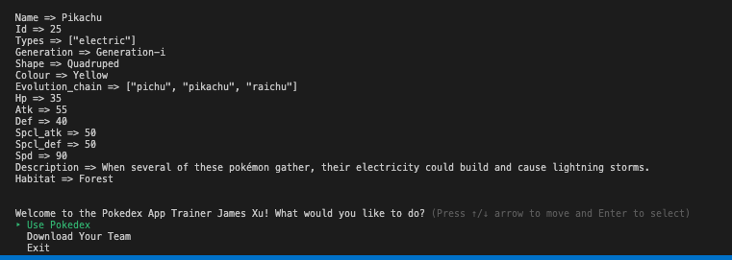
Searching for specific Pokemon by name
Displays relevant data about that Pokemon, pulls data from JSON files stored on PokeApi online

Slide 5
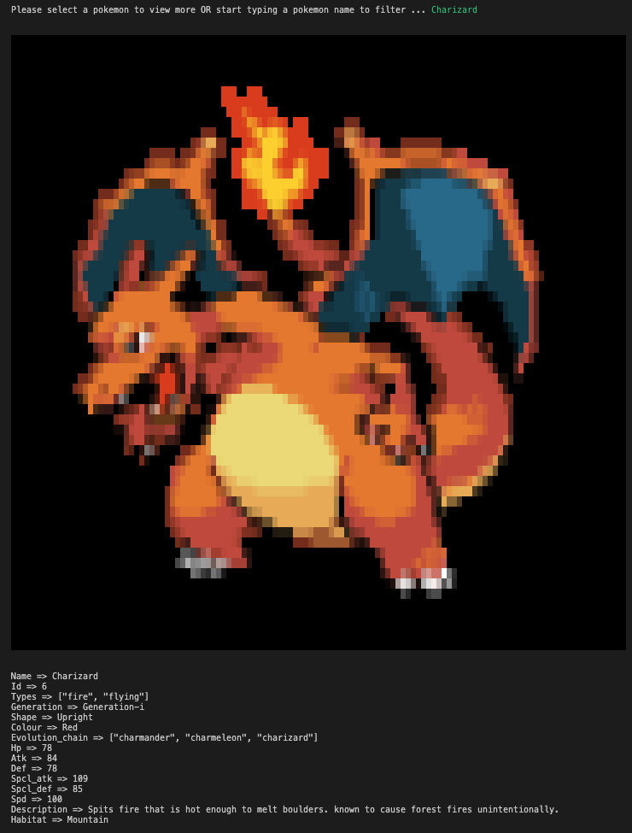
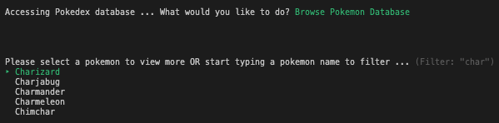
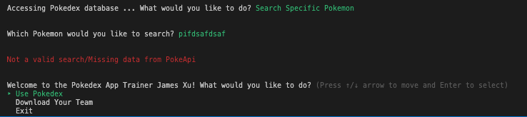
Filtering for specific Pokemon by name
Incorrect search, error message, return to home

Slide 6
In Progress
Soon to come
Obtain user input
Save to file, parse through program to pull all Pokemon data at once
Save pulled data as JSON on local machine
User may want to use pulled data in own project

Slide 7
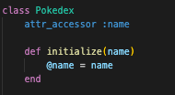
App Logic
How does it work?
Pokedex class
All pokemon api (application programming interface) calls linked to pokedex class
Using ruby gem poke-api-v2
Net/http - gem, allows http requests, connect with api

Slide 8
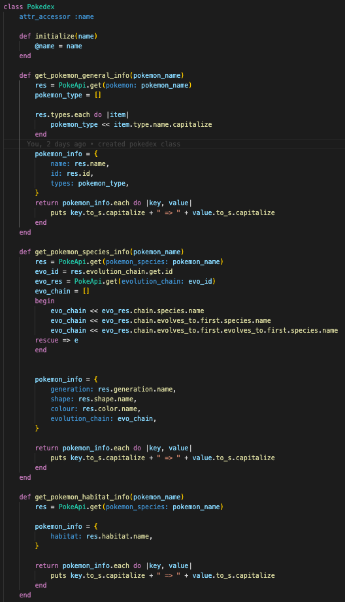
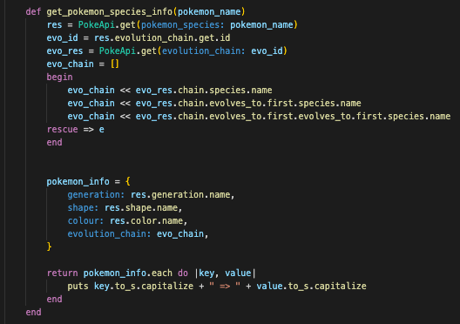
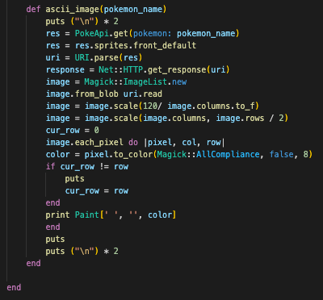
Connect with api, specify what data to pull, push into array, set k-v pairs, format data and print to screen
Converts image into pixels on terminal, parameters set using image.scale, image.rows (gems: paint, rmagick)

Slide 9
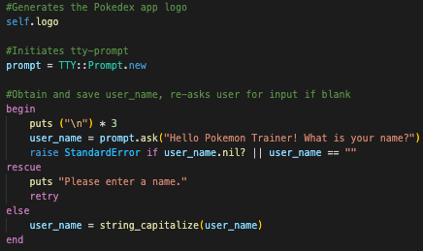
App Logic
How does it work?
Main.rb
Utilise methods to pull data when called upon in the menu
Action done, cycles back to home screen to reselect options
Nested hashes of k-v pairs to select menu option (gem: tty-prompt)

Slide 10
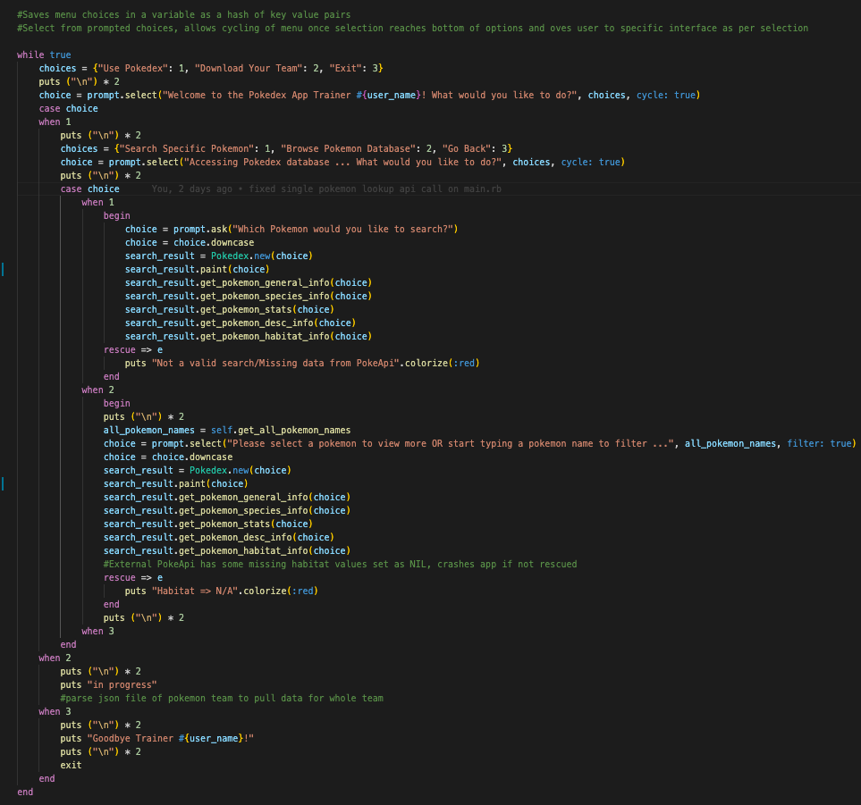
While true keeps menu system in loop; cycles back to start
Nested option using tty-prompt (select 1, 2 or 3)
Calls upon methods to pull data from api
.colorize to emphasise errors (gem: colorise)
Methods separate api calls depending on data type
\n puts to space command inputs (readability purposes)

Slide 11
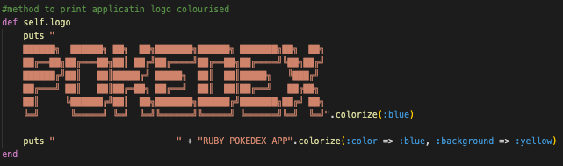
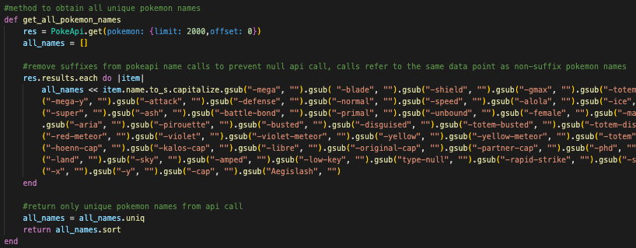
Method used to call app title screen
Selectable menu system; remove all special suffixes - leads to same data point in api (remove duplicates, reduce nil data calls)

Slide 12
Development Process Review
Challenges, favourite parts, ethics?
Challenge
Utilising APIs
Underestimating features
Keeping code DRY
Troubleshooting

Slide 13
Development Process Review
Challenges, favourite parts, ethics?
Favourite Parts
Images (rmagick, paint)
A (somewhat) operating application!
Solving issues (self-troubleshooting)

Slide 14
Development Process Review
Challenges, favourite parts, ethics?
Ethics
Ensuring API is open-source
Not profiting off copyrighted sources (pokemon)

